Slide 1
Unit 1 My friends
Lesson 3 - Period 6

Slide 2
Table of contents
Warm-up and review
Read and tick True or False.
Let’s write.
Games
Project
01
02
03
04
05

Slide 3
Warm-up and review
01

Slide 4
Work in pairs. Ask and answer.

Slide 5
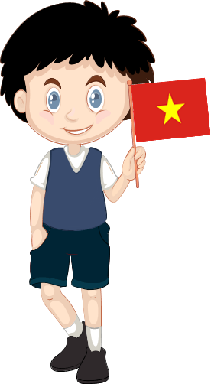
Where are you from?
I’m from
Viet Nam.

Slide 6

Where is she from?
She’s from Australia.

