Slide 1
9
Colours
LESSON 1
Period 1

Slide 2
Put your hands On my desk. Who’s the best? It’s me!

Slide 3
01
Warm-up and review

Slide 4
Look, listen and repeat.

Slide 5
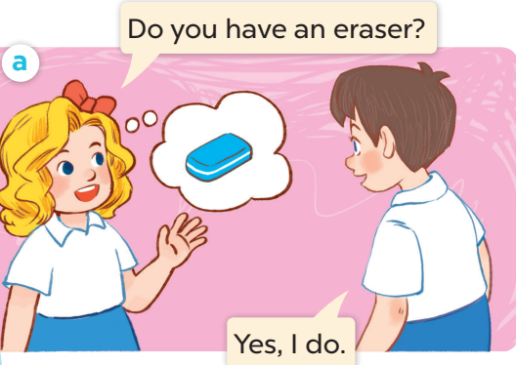
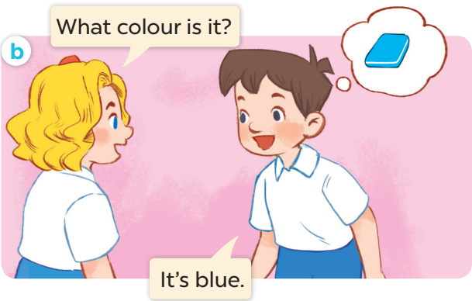
Notes:
- sau slides này chuyển sang sachmem.vn

Slide 6
Listen, point and say.

Slide 7
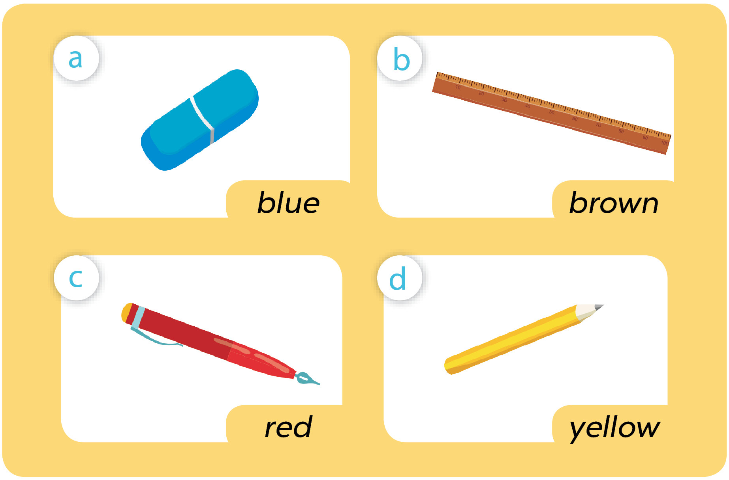
Notes:
- sau slides này chuyển sang sachmem.vn.

Slide 8
What colour is it?
blue
It’s ____ .

Slide 9
What colour is it?
brown
It’s ____ _____ .

Slide 10
What colour is it?
red
It’s ____ _____ .

Slide 11
What colour is it?
yellow
It’s ____ _____ .

Slide 12
Let’s talk.

